Slide 1
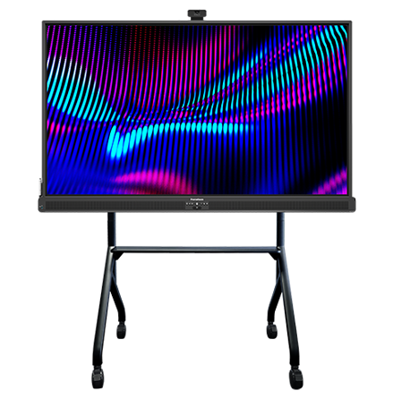
ActivPanel 10
Stand Options and Compatibility NA

Slide 2
ActivPanel 10
 | 65” | 75" | 86” | Comments
Fixed Wall Mount | AP-WALLMNT or AP-WALLMNT-2 | AP-WALLMNT or AP-WALLMNT-2 | AP-WALLMNT or AP-WALLMNT-2 | AP-WALLMNT-2 not included with ActivPanel 10
Height-Adjustable Wall Mount | AP-ASW-70* AP-ASF-70* | AP-ASW-70* AP-ASF-70* | AP-ASW-90* AP-ASF-90* | AP-ASW bundles include Height-Adjustable Mount AP-ASF bundles include Height-Adjustable Mount and Floor Support
Height-Adjustable Mobile Stand | AP-ASM-70* |  | AP-ASM-TR-90* (100 mm castors required) | AP-ASM bundles include Height-Adjustable Mount, Mobile Stand and Cover Kit AP-ASM-TR bundles include Height-Adjustable Mount and Mobile Stand
Fixed Height Mobile Stand | AP-FSM-WH AP-FSM* | AP-FSM-WH AP-FSM* | AP-FSM-WH AP-FSM*
* AP-WALLMNT or AP-WALLMNT-2 required

Slide 3
ActivPanel 10 Premium
 | 55" | 65” | 75" | 86” | Comments
Fixed Wall Mount | AP-WALLMNT or AP-WALLMNT-2 | AP-WALLMNT or AP-WALLMNT-2 | AP-WALLMNT or AP-WALLMNT-2 | AP-WALLMNT or AP-WALLMNT-2 | AP-WALLMNT-2 not included with ActivPanel 10 Premium
Height-Adjustable Wall Mount |  | AP-ASW-70* AP-ASF-70* | AP-ASW-70* AP-ASF-70* | AP-ASW-90* AP-ASF-90* | AP-ASW bundles include Height-Adjustable Mount AP-ASF bundles include Height-Adjustable Mount and Floor Support
Height-Adjustable Mobile Stand |  | AP-ASM-TR-70* (100 mm castors required) | AP-ASM-TR-70* (100 mm castors required) | AP-ASM-TR-90* (100 mm castors required) | AP-ASM-TR bundles include Height-Adjustable Mount and Mobile Stand
Fixed Height Mobile Stand | AP-FSM-WH AP-FSM* AP-FSM-TR* (100 mm castors required) | AP-FSM-WH AP-FSM* AP-FSM-TR* (100 mm castors required) | AP-FSM-WH AP-FSM* AP-FSM-TR* (100 mm castors required) | AP-FSM-WH AP-FSM*
* AP-WALLMNT or AP-WALLMNT-2 required

